Slide 1

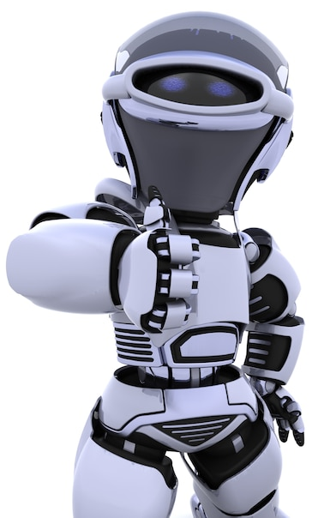
Artificial Intelligence – 30 Days Challenge - தமிழ்
Intro to AI | Creating Our Own Chatbot
DAY 1 / 30

Slide 2
Prerequisites for this Course
Laptop with Good Internet
No basic knowledge is required
Note & Pen

Slide 3
Problems in Learning
😥
More Duration
Hard to Understand
Not able to create Application
Not Interactive
Not Presise
Problem in Lack of Information

Slide 4



Solution
Probem is not a lack of information
Problem is Information Overload
What People Need?
Clearcut Presise & focused implementation with Clear mentorship
Application Based Learning

Slide 5
Knowing + Not Doing = Not Knowing

Slide 6
“Learn to be a Lifelong Learner”

Slide 7
NoviTech R&D Pvt Ltd
Service to Industry
Service to Education Sector
Product Design & Development
Research and Development
Industrial Project
Software Development & Service
Faculty Development Program
Internship
Hands on Workshop
Industrial Visit
Guess Lecture
Project Guidance

Slide 8

About Me
Muthuvel Ramesh T
AI Developer
Novitech R&D Pvt Ltd.,
70+ projects
Trained 1200+ students
AI,ML,DL,DS,NLP

Slide 9

Our Mission
Investing in Students Growth
Discover. Develop. Excel

Slide 10
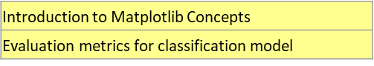
What Will You Learn in 30 Days?
Deep Learning
Introduction to DL| how to install DL libraries
Deep Learning Algorithms | Neural Network Design
Real-time Object recognition using Pre-trained Model
Image Classification using Convolutional Neural Networks
Hand Gesture Recognition with Deep Learning
Detecting Plant Leaf Diseases using Deep Learning
Character Recognition with CNN and PyQt5 GUI
Label reading using Optical Character Recognition OCR
Attendance System Face Recognition using DL & ML
Vehicle Detection and Tracking
License Plate Recognition System
Drowsiness Detection for Driver Safety
Road Sign Recognition for Autonomous Vehicles
Artificial Intelligence
Introduction to AI | Creating your own Chatbot using DialogFlow and Integration
Exploring various python platforms | Installing & Working with Python IDLE
Computer Vision
Introduction to Computer Vision | Overview on CV libraries & installation
Moving Object Detection using OpenCV
Advanced Face Detection and Tracking
Object Tracking based on Color with OpenCV
Face Recognition with OpenCV
Recognizing Emotions from Faces
Machine Learning
Introduction to Machine Learning | ML Algorithms
Heart Disease Prediction using Machine Learning
Titanic Survival prediction using NAIVE BAYES
AI Snake Game - Reinforcement Learning
NATURAL LANGUAGE PROCESSING
Natural Language Processing Essentials
Generating Titles from Text using NLP
Analyzing Speech and Emotions using CNN and NLP

Slide 11

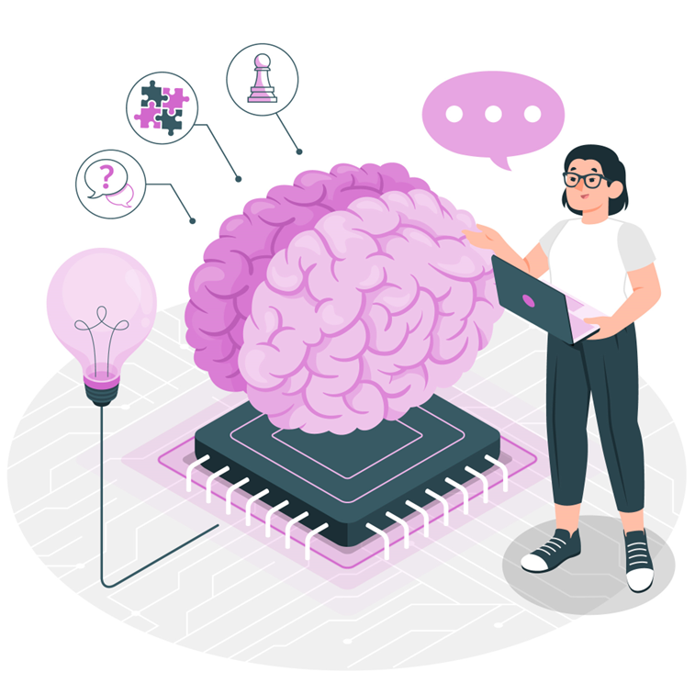
Artificial
Intelligence
Chatbot Creation & Integration

Slide 12
Pain for Learners
😥
Price
Lack of Confidence
Earning
Vacancy
Trust
Overload

Slide 13
Solution for Learners
😥
How about to get High Paying job?
How about Transparent Environment?
How about Less Price?
Price
Lack of Confidence
Earning
Vacancy
Trust
Overload
How about Learning mindset to achieve which you want?
How about it should be in demanded skill?
How about precise content with application based learning?

Slide 14
Artificial
Intelligence

Slide 15
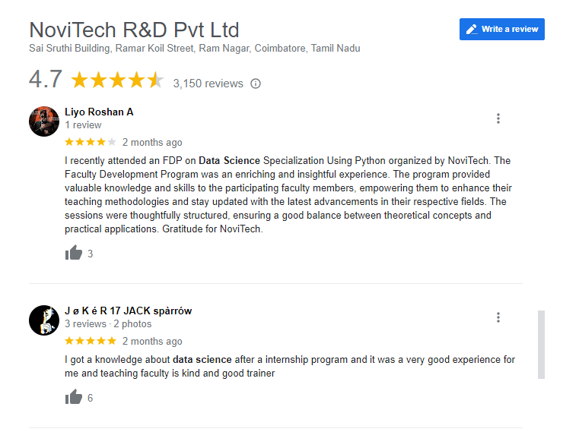

Google Review

Slide 16




THANK YOU☺
NOVITECH COIMBATORE
novitechresearchanddevelopment

